Slide 1
Combining Machinekit and ROS for RT Motion Control with ROS1 or ROS2
Alexander Rössler

Slide 2
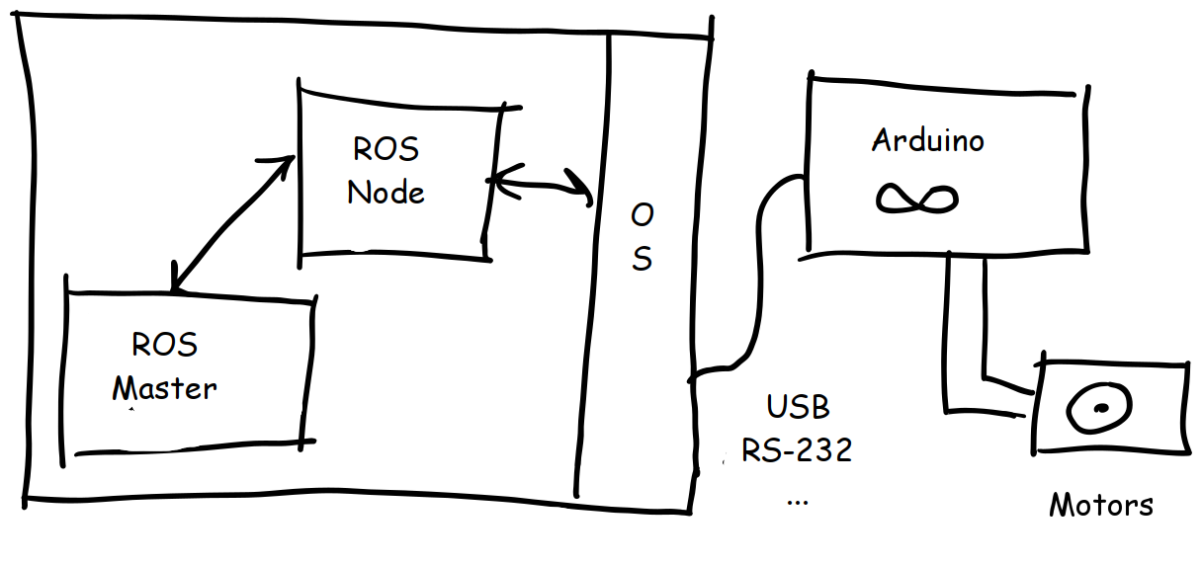
Current Motion Control

Slide 3
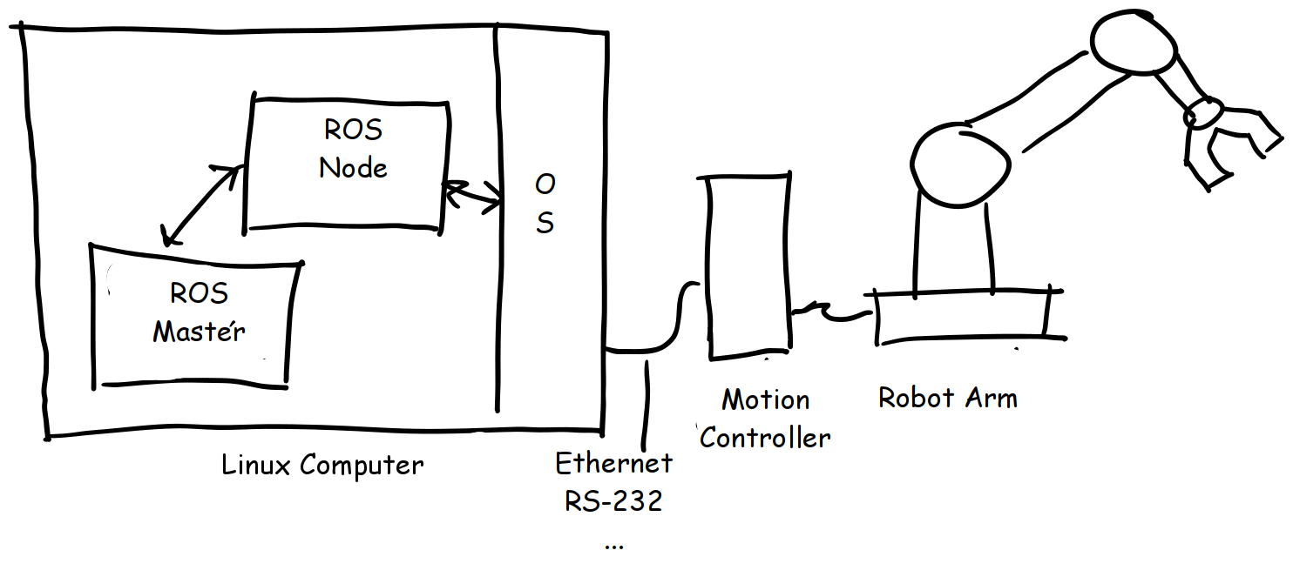
Current Motion Control

Slide 4
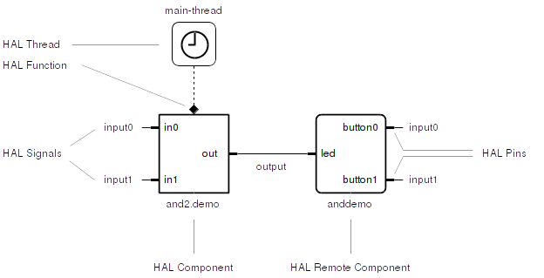
Machinekit HAL

Slide 5
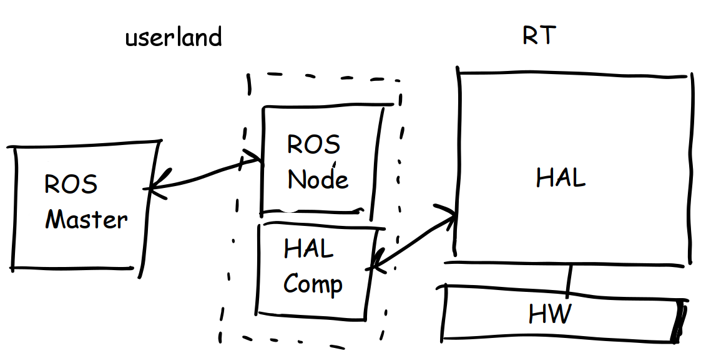
ROS Node → HAL Comp

Slide 6
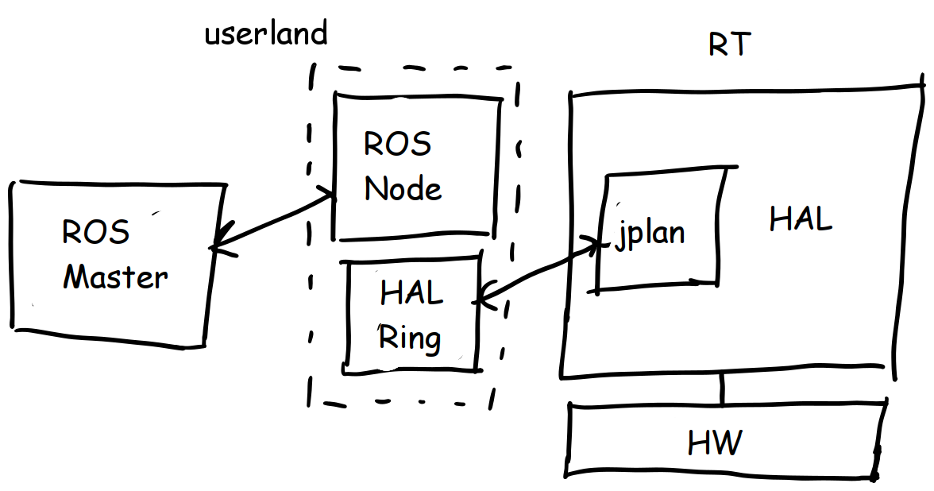
ROS Node → HAL Playout

Slide 7
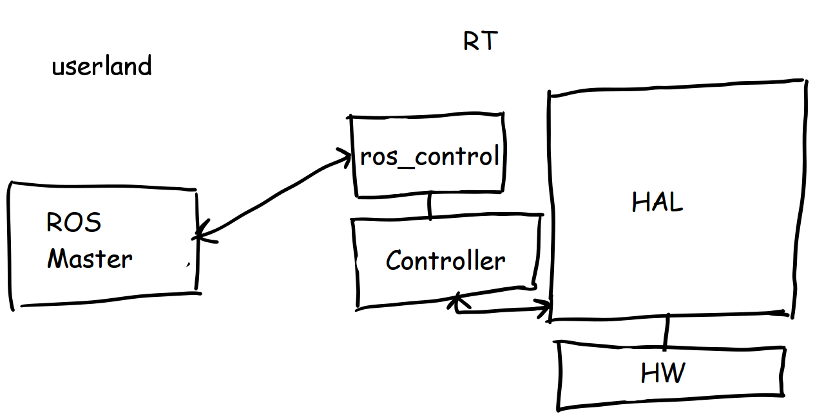
Machinekit ROS Control

Slide 8
Links + Questions?
https://machinekoder.com/machinekit-ros-open-source-robots/
http://machinekit.io
alex@machinekoder.com

